Slide 1
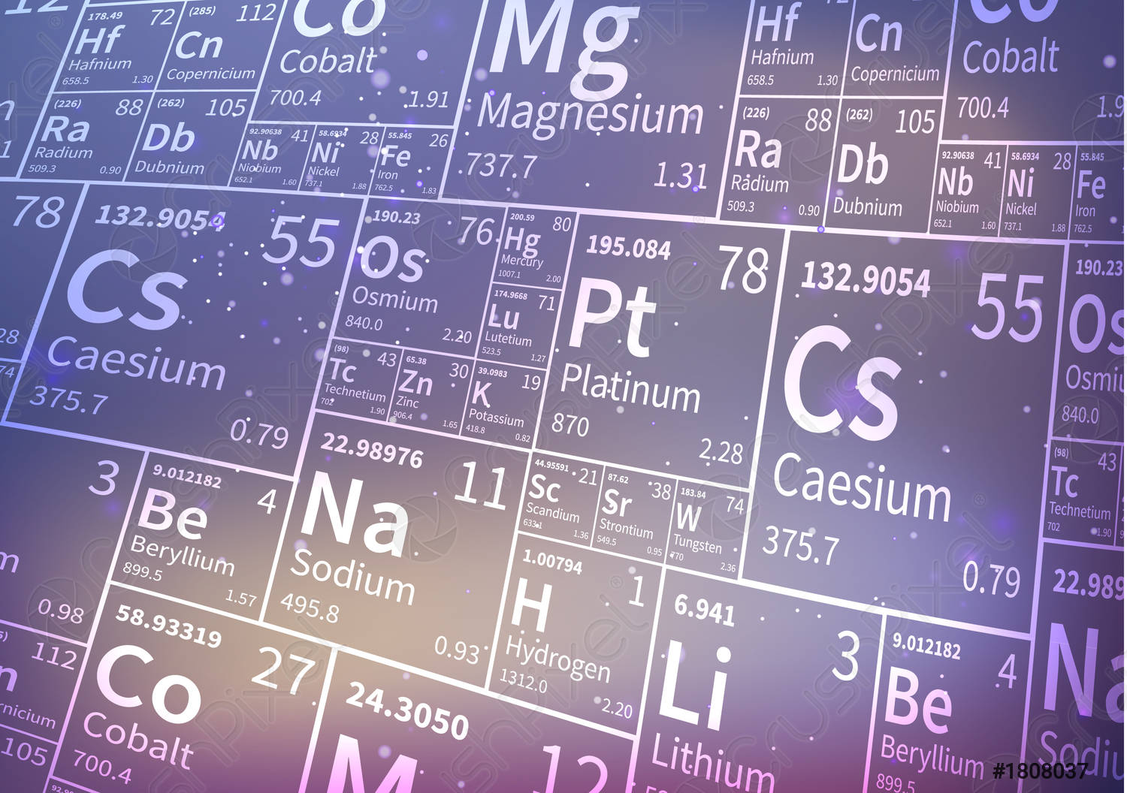


Chào mừng quý Thầy Cô & các bạn sinh viên
đến với buổi tập huấn
Hướng dẫn phát âm
tên nguyên tố & hợp chất hóa học
bằng tiếng Anh
PGS. TS. Nguyễn Đông Hải
Tennessee Wesleyan University, Mỹ

Slide 2
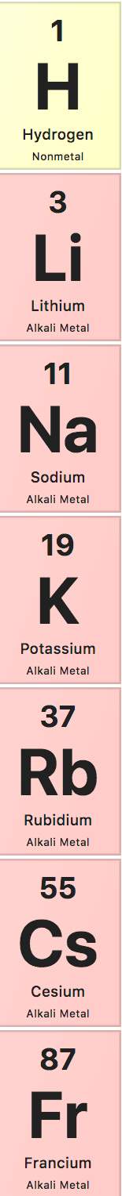
The Alkali Metals
Hydrogen /ˈhaɪdrədʒən/
Lithium /ˈlɪθiəm/
Sodium /ˈsəʊdiəm/
Potassium /pəˈtæsiəm/
Rubidium /ruːˈbɪdiəm/
Caesium /ˈsiːziəm/
Francium /ˈfrænsiəm/

Slide 3

The Alkaline Earth Metals
Beryllium /bəˈrɪliəm/
Magnesium /mæɡˈniːziəm/
Calcium /ˈkælsiəm/
Strontium /ˈstrɒntiəm/
Barium /ˈbeəriəm/
Radium /ˈreɪdiəm/

Slide 4

The Boron Group
Boron /ˈbɔːrɒn/
Aluminium /ˌæljəˈmɪniəm/
Gallium /ˈgæliəm/
Indium /ˈɪndiəm/
Thallium /ˈθæliəm/

Slide 5

The Carbon Group
Carbon /ˈkɑːbən/
Silicon /ˈsɪlɪkən/
Germanium /dʒəˈmeɪniəm/
Tin /tɪn/
Lead /led/

Slide 6

The Pnictogens
Nitrogen /ˈnaɪtrədʒən/
Phosphorus /ˈfɒsfərəs/
Arsenic /ˈɑːsnɪk/
Antimony /ˈæntɪməni/
Bismuth /ˈbɪzməθ/

Slide 7

The Chalcogens
Oxygen /ˈɒksɪdʒən/
Sulfur /ˈsʌlfə(r)/
Selenium /səˈliːniəm/
Tellurium /teˈljəriəm/
Polonium /pəˈləʊniəm/

Slide 8

The Halogens
Fluorine /ˈflʊəriːn/
Chlorine /ˈklɔːriːn/
Bromine /ˈbrəʊmiːn/
Iodine /ˈaɪədiːn/ /ˈaɪədaɪn/
Astatine /ˈastətiːn/

Slide 9

The Noble Gases
Helium /ˈhiːliəm/
Neon /ˈniːɒn/
Argon /ˈɑːrɡɑːn/
Kripton /ˈkrɪptɒn/
Xenon /ˈziːnɒn/
Radon /ˈreɪdɒn/

Slide 10






Common B-group Elements
Scandium /ˈskændiəm/
Titanium /taɪˈteɪniəm/
Chromium /ˈkrəʊmiəm/
Manganese /ˈmæŋɡəniːz/
Iron /ˈaɪən/
Cobalt /ˈkəʊbɔːlt/

Slide 11





Common B-group Elements
Nickel /ˈnɪkl/
Copper /ˈkɒpə(r)/
Zinc /zɪŋk/
Silver /ˈsɪlvə(r)/
Tungsten /ˈtəŋstən/

Slide 12



Common B-group Elements
Platinum /ˈplætɪnəm/
Gold /ɡəʊld/
Mercury /ˈmɜːkjəri/

Slide 13
Ions
Cations
K⁺ : potassium ion
Mg²⁺ : magnesium ion
Al³⁺ : aluminium ion
Fe²⁺ : iron (II) ion
Fe³⁺ : iron (III) ion

Slide 14
Ions
Anions
Cl⁻ : chloride ion
O²⁻ : oxide ion
N³⁻ : nitride ion

Slide 15
Ionic Compounds
Compounds containing only monatomic ions
NaCl : sodium chloride
CaI₂ : calcium iodide
Na₂O : sodium oxide
Mg₃N₂ : magnesium nitride
Ca₃P₂ : calcium phosphide
Al₄C₃: aluminum carbide

Slide 16
Ionic Compounds
Compounds containing polyatomic ions
NH₄Cl : ammonium chloride
CaSO₄ : calcium sulfate
Al₂(CO₃)₃ : aluminum carbonate
NaHCO₃ : sodium bicarbonate
Mg₃(PO₄)₂ : magnesium phosphate
KC₂H₃O₂ : potassium acetate

Slide 17
Ionic Compounds
Compounds containing a metal ion with variable charges
FeCl₂ : iron(II) chloride / ferrous chloride
FeCl₃ : iron(III) chloride / ferric chloride
Cu₂O: copper (I) oxide / cuprous oxide
CuO: copper (II) oxide / cupric oxide
CrO: chromium (II) oxide / chromous oxide
Cr₂O₃: chromium (III) oxide / chromic oxide

Slide 18
Ionic Compounds
Ionic hydrates
CuSO₄.5H₂O : copper(II) sulfate pentahydrate
Na₂CO₃.10H₂O sodium carbonate decahydrate
Nomenclature Prefixes
Quantity | Prefix
1 | Mono /ˈmɒnəʊ/
2 | Di /dɑɪ/
3 | Tri /trɑɪ/
4 | Tetra /ˈtetrə/
5 | Penta /pentə/
Quantity | Prefix
6 | Hexa /heksə/
7 | Hepta /ˈheptə/
8 | Octa /ˈɒktə/
9 | Nona /nɒnə/
10 | Deca /dekə/

Slide 19
Covalent Compounds
Compounds with two elements
NO₂ : nitrogen dioxide
N₂O : dinitrogen oxide
N₂O₅: dinitrogen pentoxide
BCl₃ : boron trichloride
IF₇ : iodine heptafluoride

Slide 20
Acids
Binary acids
Gas | Acid
HF(g) : hydrogen fluoride | HF(aq) : hydrofluoric acid
HCl(g) : hydrogen chloride | HCl(aq) : hydrochloric acid
HBr(g) : hydrogen bromide | HBr(aq) : hydrobromic acid
HI(g) : hydrogen iodide | HI(aq) : hydroiodic acid
H₂S(g) : hydrogen sulfide | H₂S(aq) : hydrosulfuric acid

Slide 21
Acids
Oxyacids
Formula | Anion Name | Acid Name
HNO₂ | nitrite | nitrous acid
HNO₃ | nitrate | nitric acid
H₂CO₃ | carbonate | carbonic acid
HClO | hypochlorite | hypochloruos acid
HClO₂ | chlorite | chloruos acid
HClO₃ | chlorate | chloric acid
HClO₄ | perchlorate | perchloric acid
H₂SO₃ | Sulfite | sulfurous acid
H₂SO₄ | sulfate | sulfuric acid
HC₂H₃O₂ | acetate | acetic acid

Slide 22
Bases
NaOH : sodium hydroxide
Ba(OH)₂ : barium hydroxide
Fe(OH)₂ : iron (II) hydroxide / ferrous hydroxide
Fe(OH)₃ : iron (III) hydroxide / ferric hydroxide

Slide 23
Quiz
Write the names of the following compounds
Na₂O
ClO₂
Cr₂O₃
AgNO₃
N₂O₄
FeCl₂
K₂SO₃
K₃P
MnO₂
NaNO₂
Ag₂S
Fe₂O₃
CO₂
SiO₂
CrO₃
NO₂
AlF₃.3H₂O
CoCl₂.6H₂O

